Slide 1


Saturday 30 June 2012

Slide 2
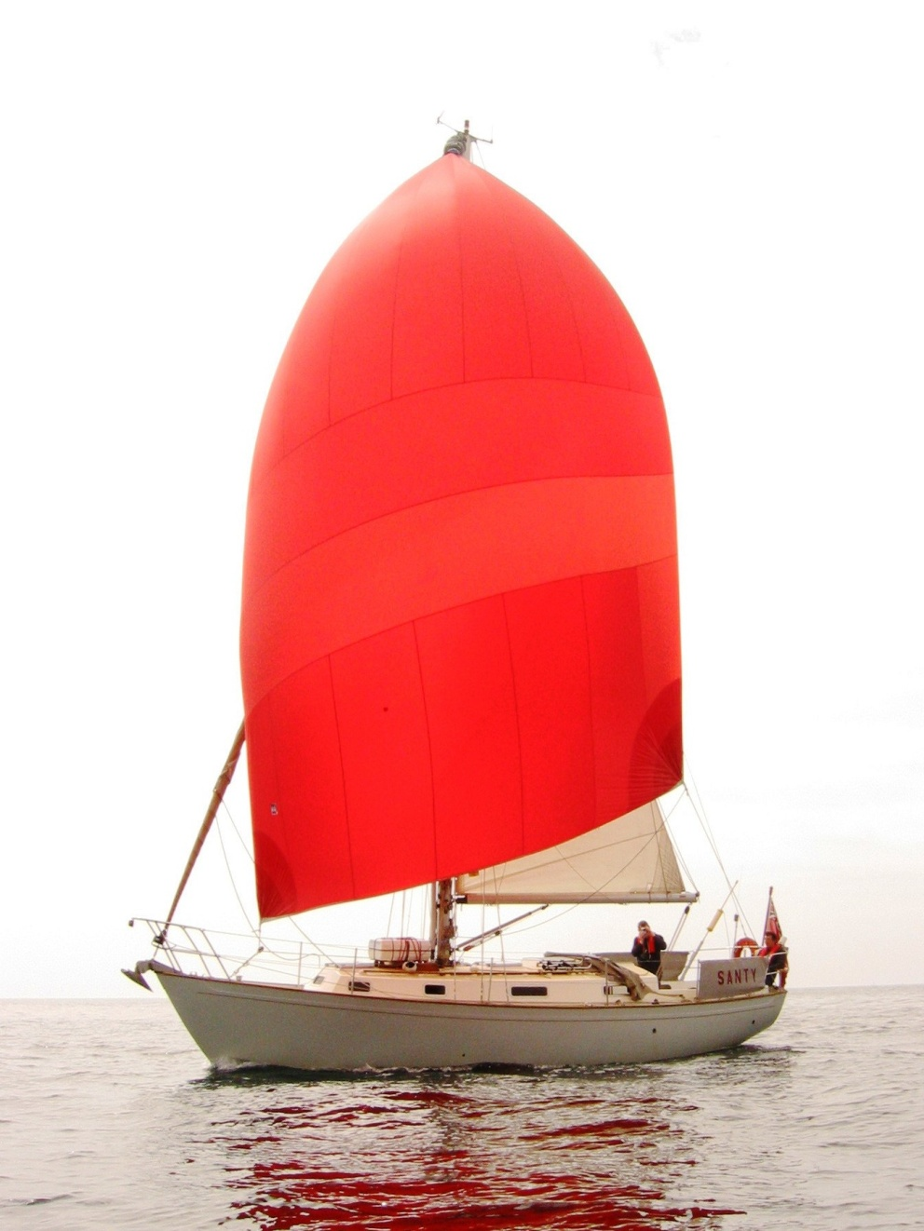
Santy Victoria 34

Slide 3
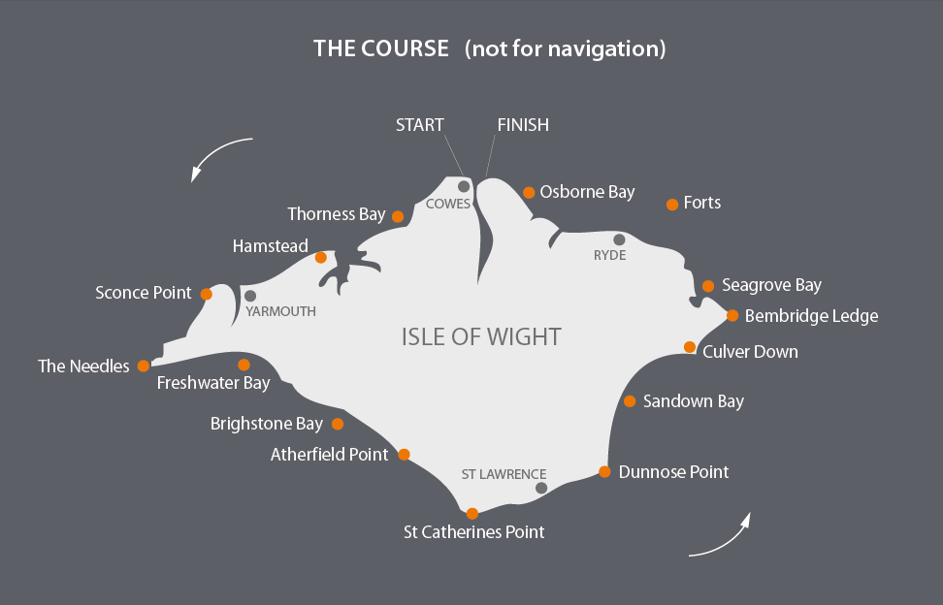
The Course

Slide 4
The History
The first race 1931 with 25 entries
The idea of Major Cyril Windeler
Won by “Merry Conceit” 22ft fishing boat
Gold Roman Bowl - replica of Roman bowl
2008 – 1,875 entrants
Won 4 times by Ted Heath
Multi hull record of 3 hours 8 min 23 secs
Mono hull record 3 hours 53 min 5 secs

Slide 5
The Course

Slide 6
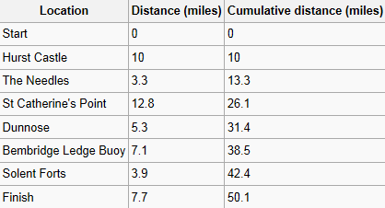
Distances

Slide 7
Tides and Wind
Start selected for a “fair” Ebb tide in W Solent and through Needles Channel.
Foul / Fair tide S of the Island
Foul tide until about 20.00 in E Solent
With prevailing Westerly
Beat at the beginning and end of the day
The end of the race can be challenging

Slide 8
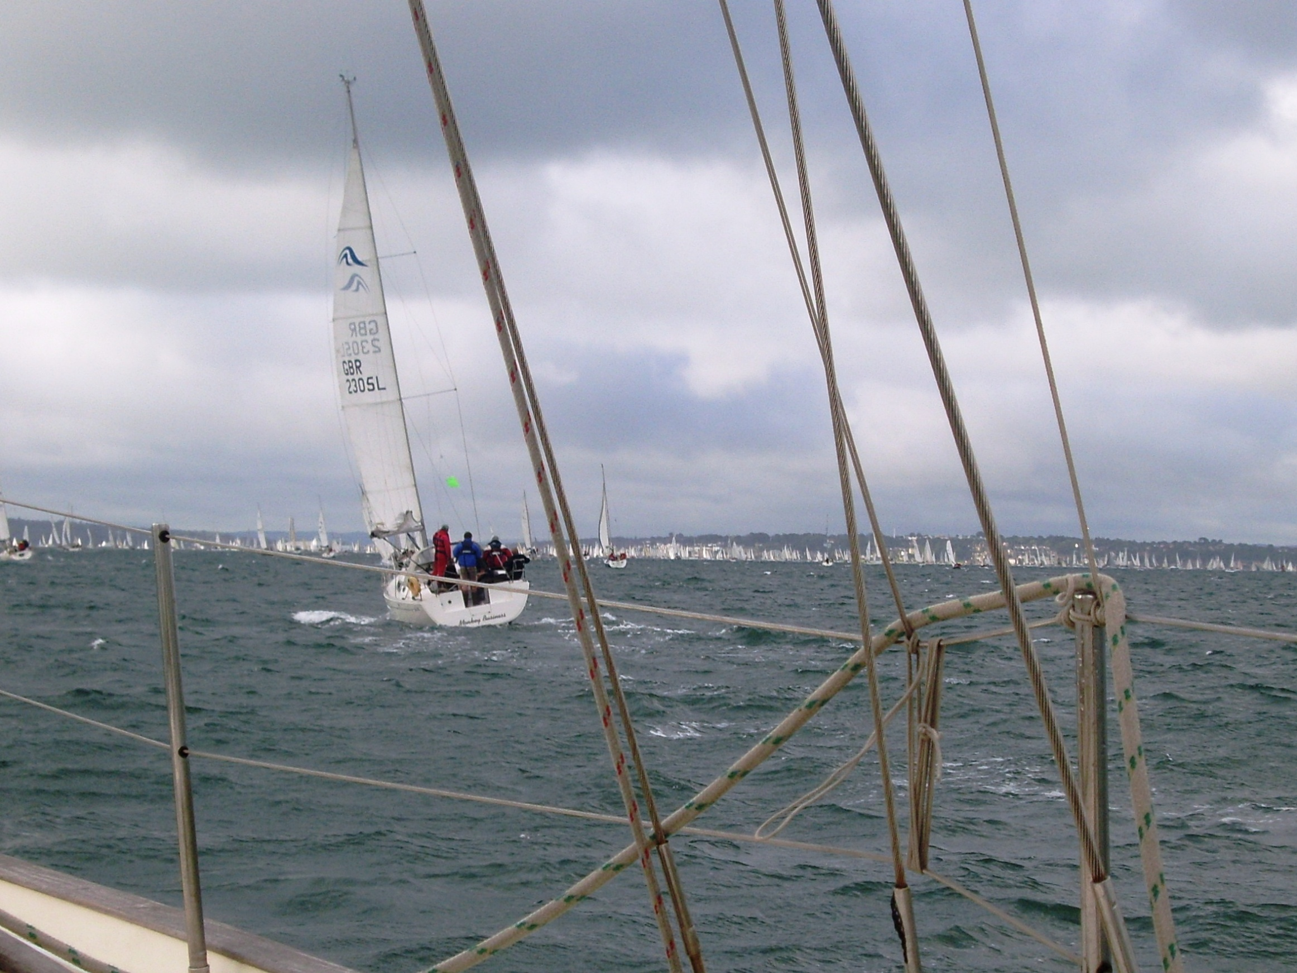
Approaching the Start

Slide 9
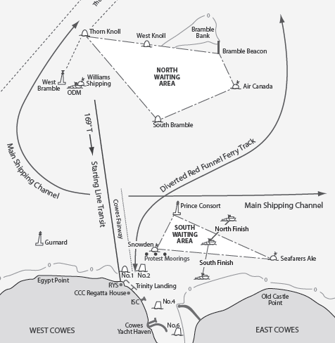
The Start
Tide 1.5 kts
Wind F5

Slide 10
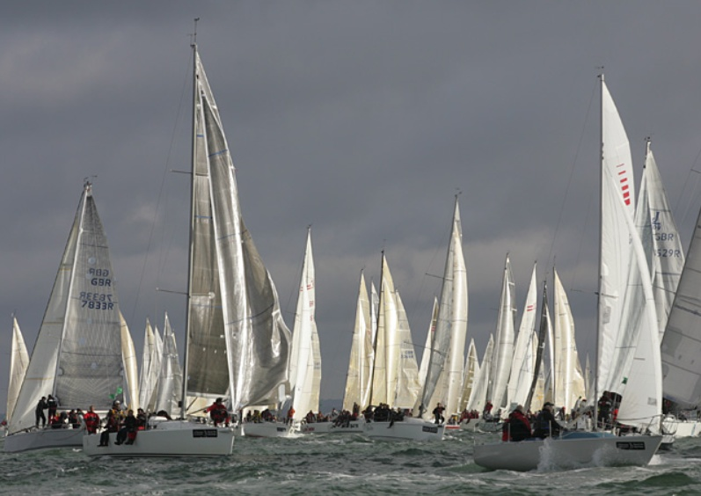
Start line 1 nm
Class 7 - 190 yachts

Slide 11
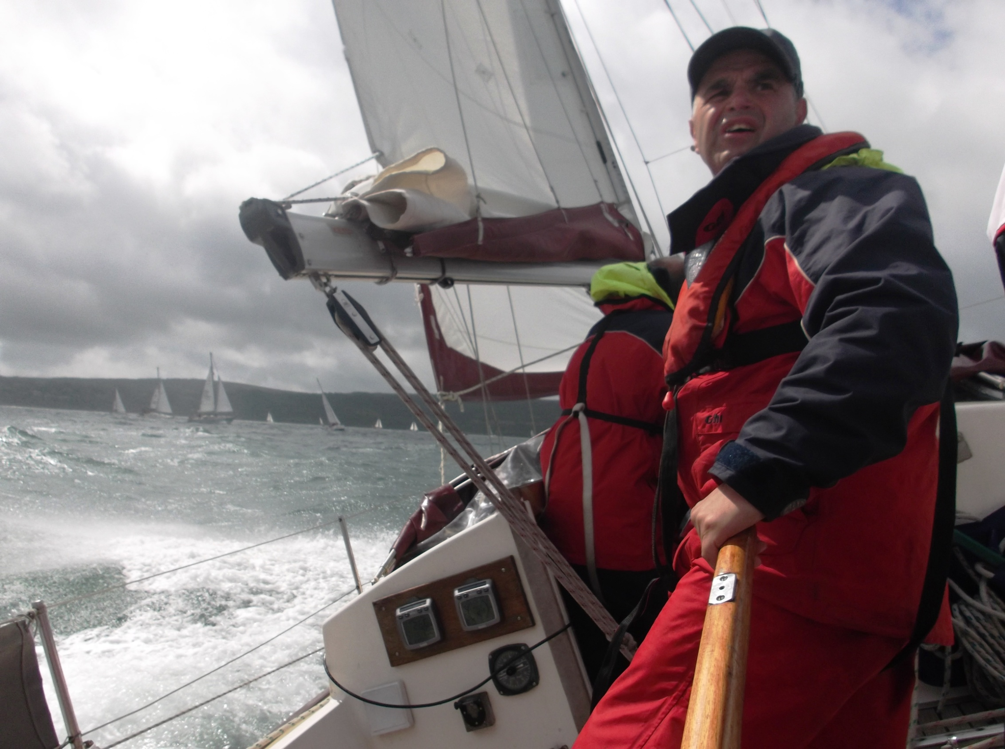
In the Western
Solent

Slide 12
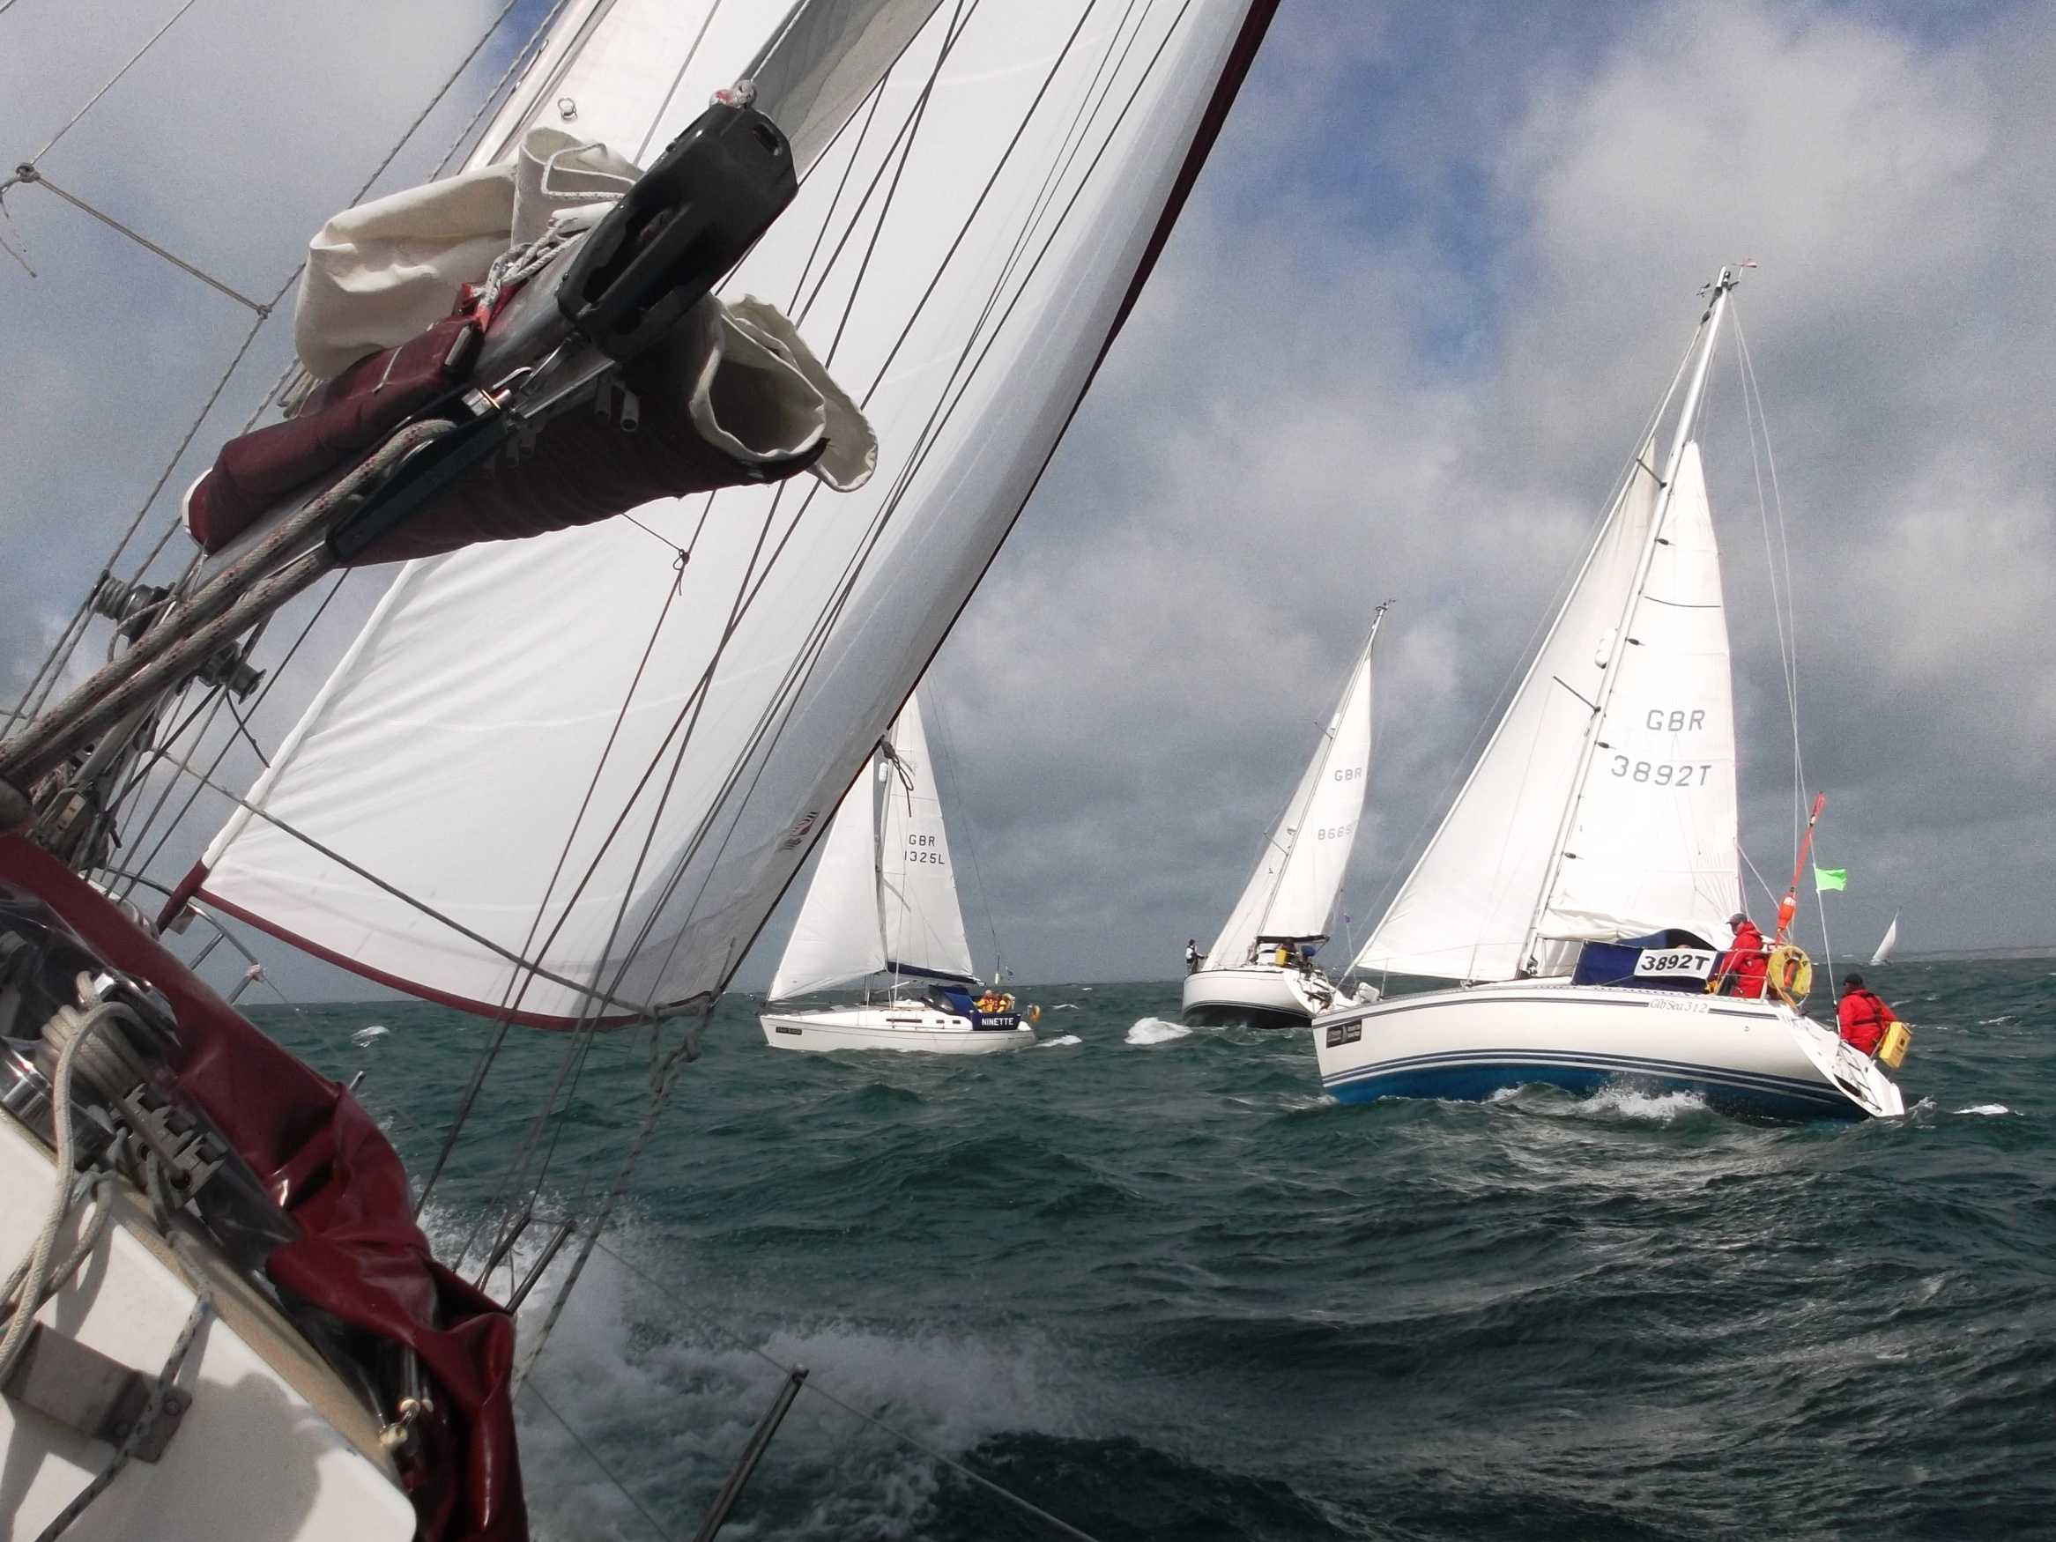
Needles
Channel

Slide 13
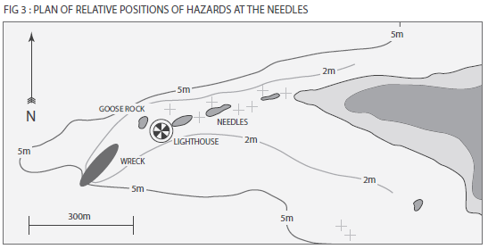
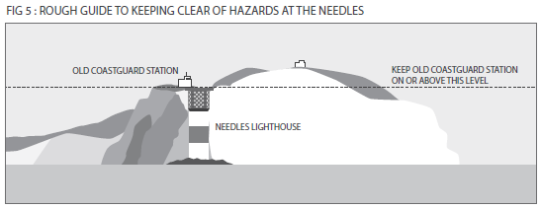
The Needles

Slide 14
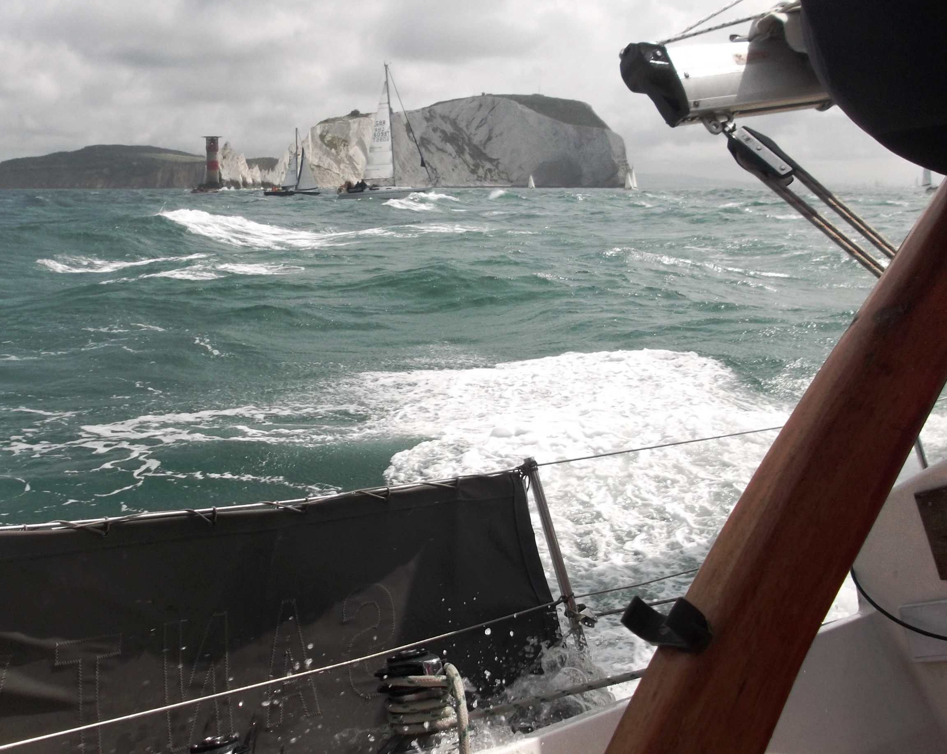
Off the Needles

Slide 15
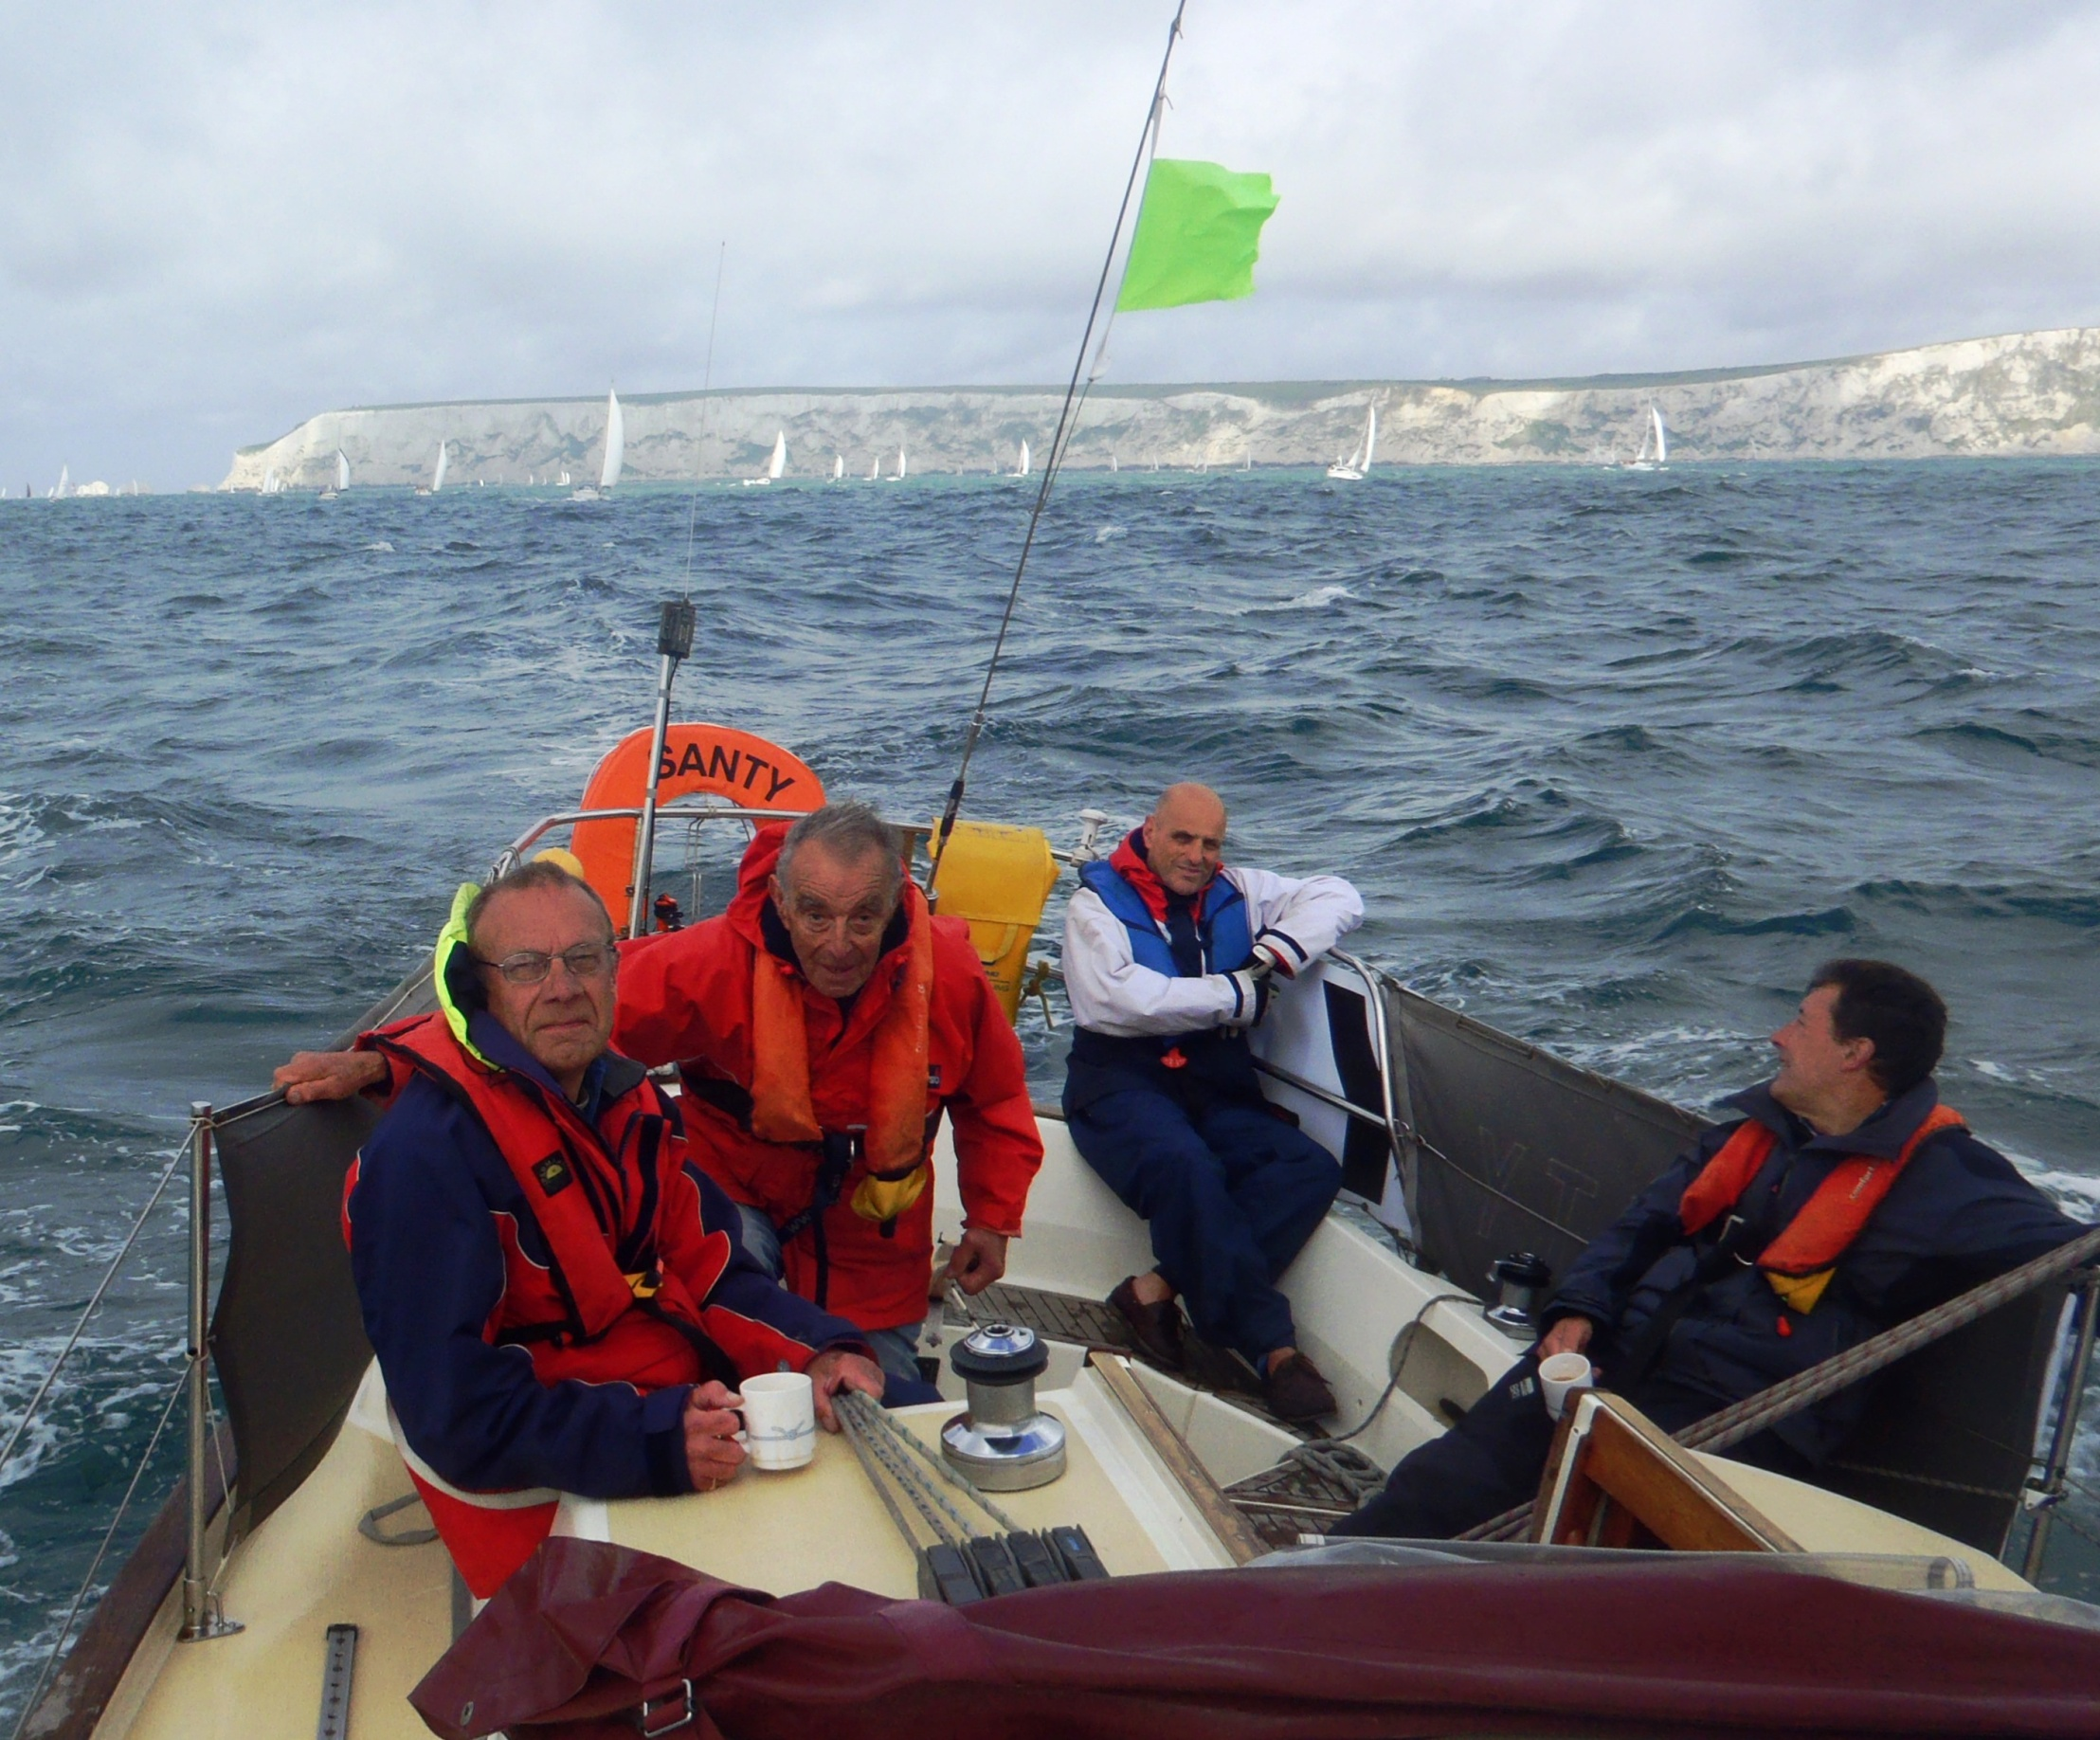
South of the Island

Slide 16
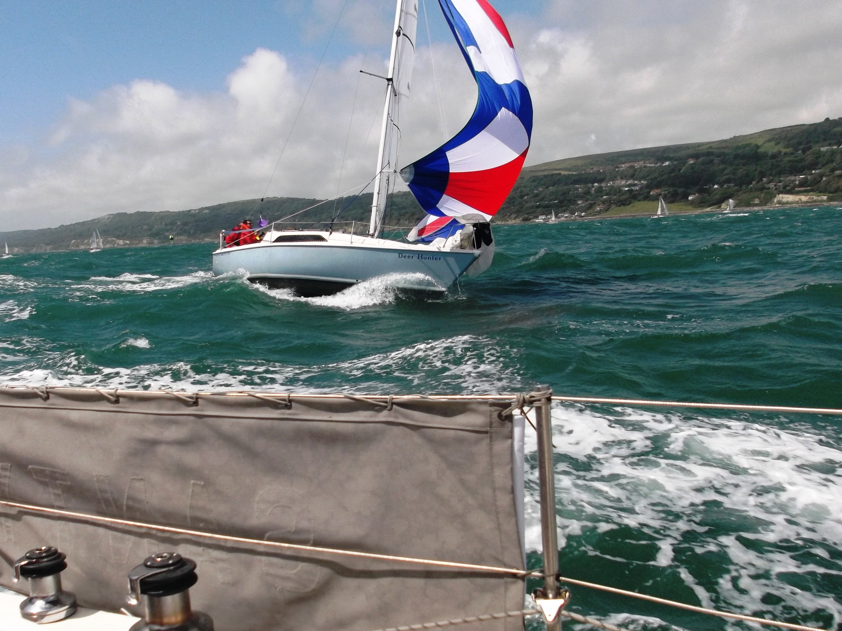
Close to
broaching?

Slide 17
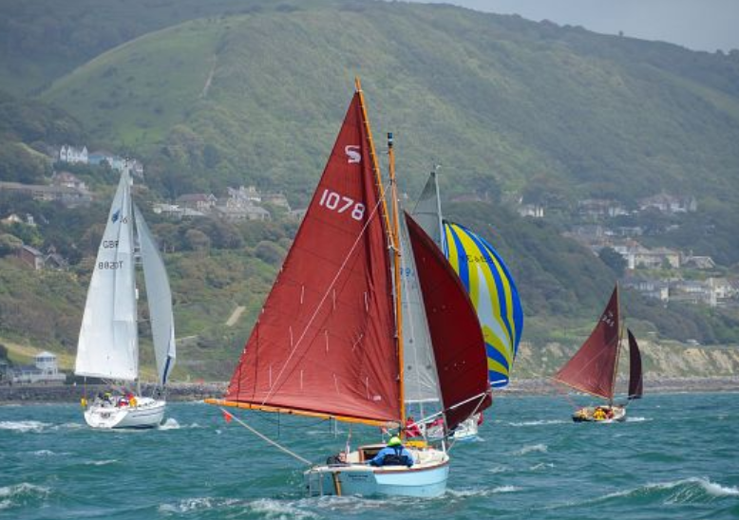
Every size of boat

Slide 18
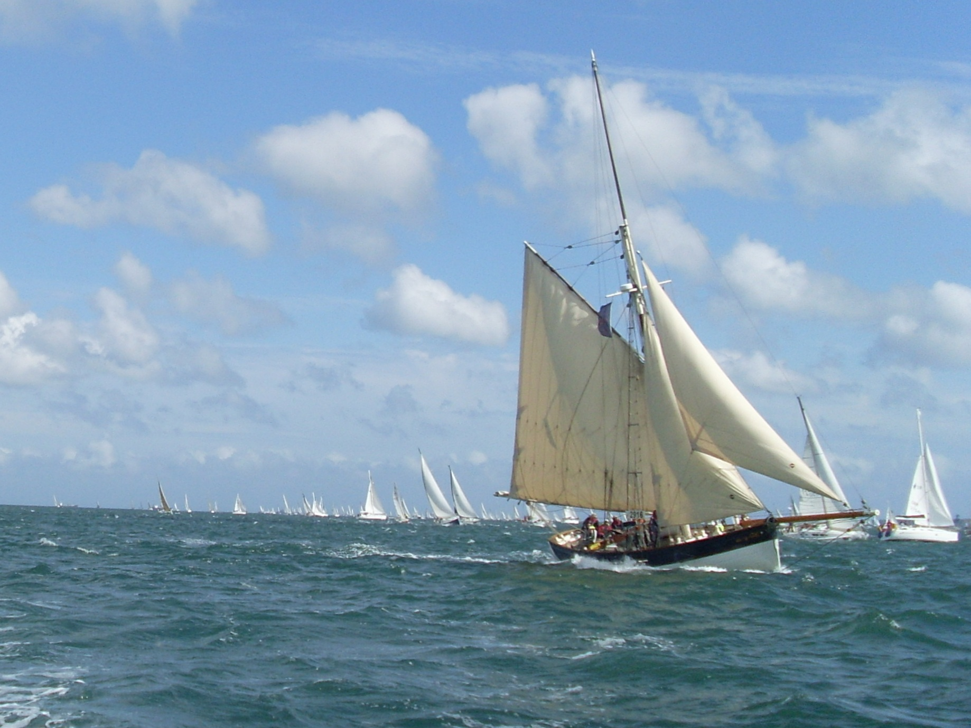
The Eastern Solent

Slide 19
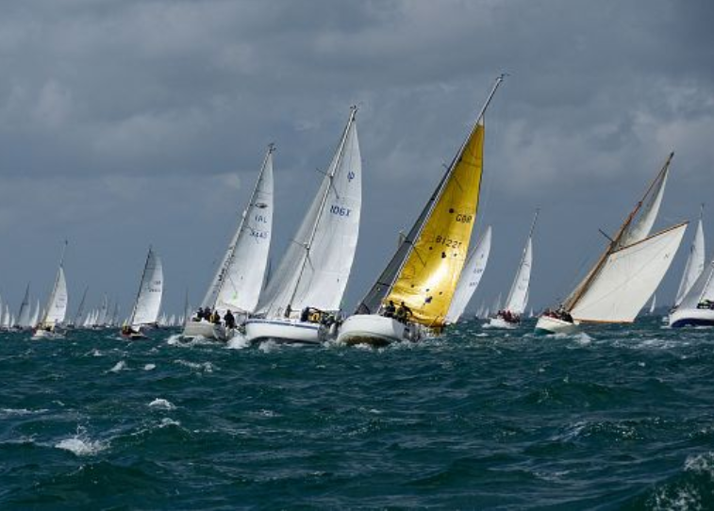
The Finish

Slide 20
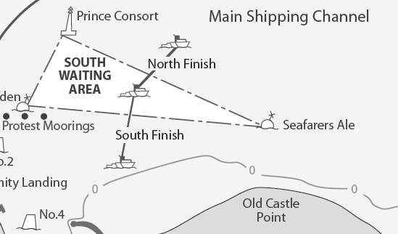
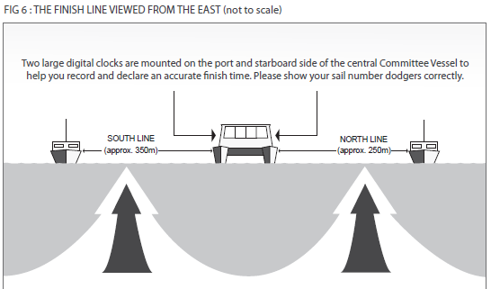
The Finish
Tide 1.5 kts
Wind F5

Slide 21
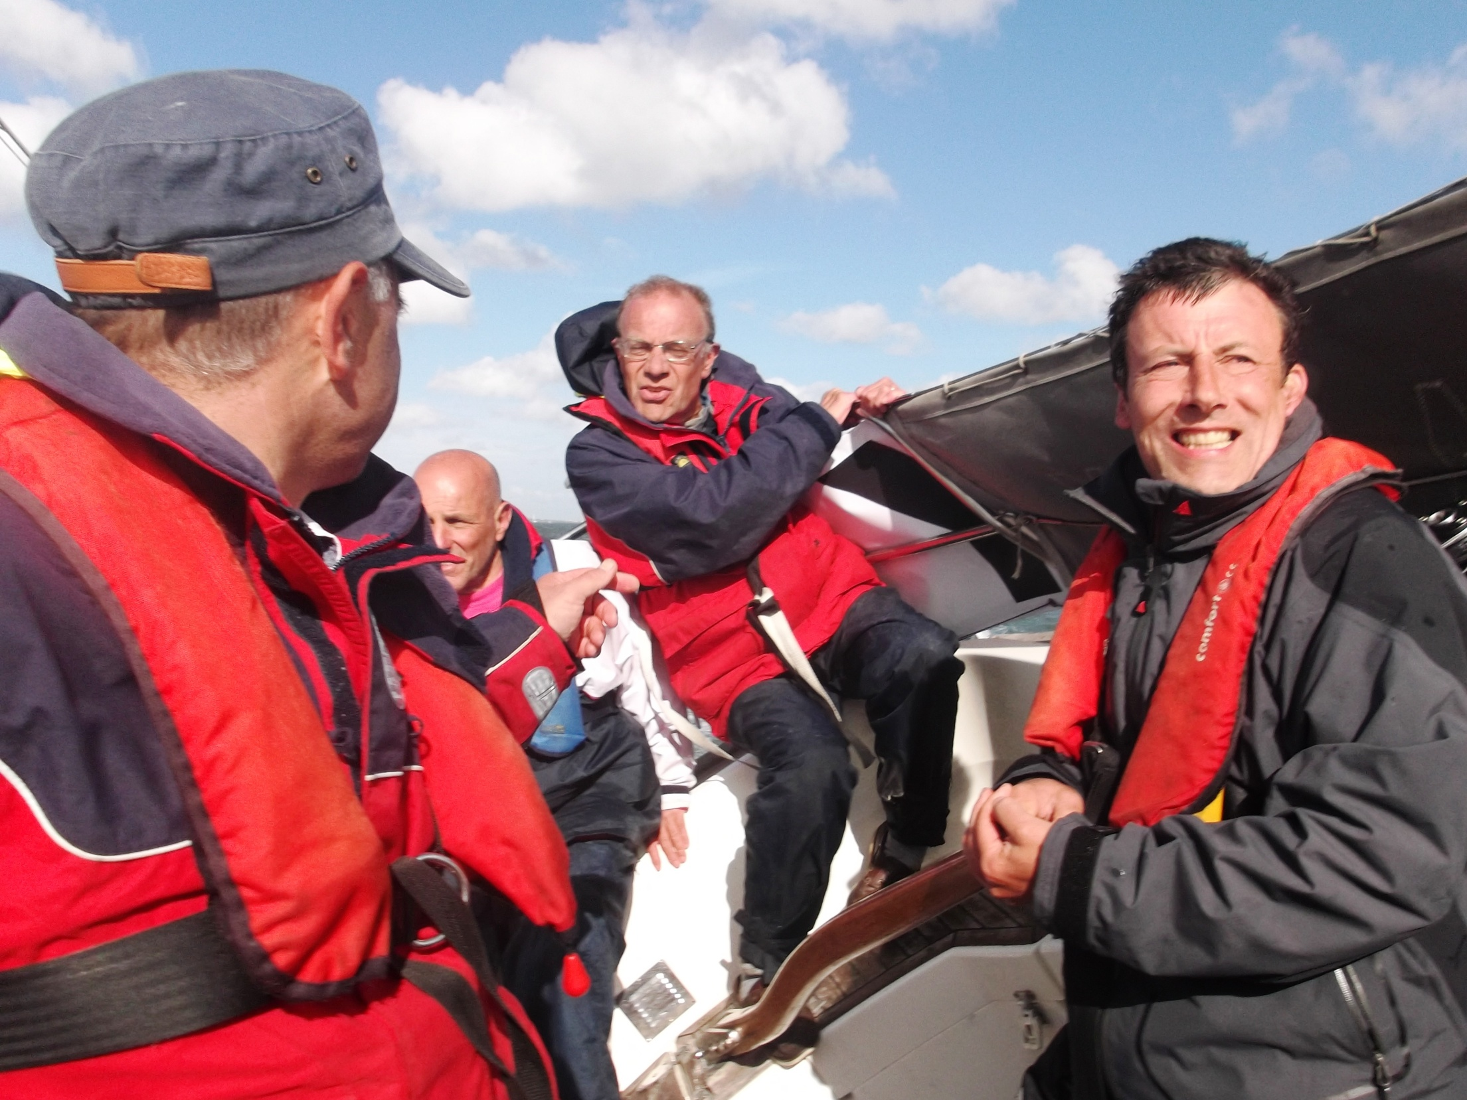
The Crew

Slide 22
IRC Handicap
Based on size, weight, sail area
RORC Rating Office
TCC (Time Correction)
Elapsed time x TCC = Corrected time
10 hours x 0.95 = 9 hours 30 min
10 hours x 1.00 = 10 hours!
10 hours x 1.05 = 10 hours 30 min

Slide 23
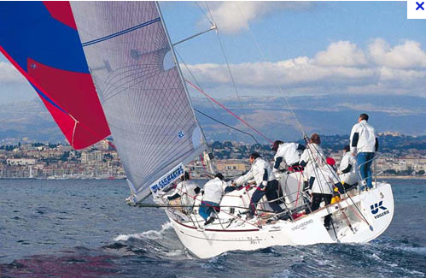
Handicap of 1.00
Beneteau First 36.7

Slide 24
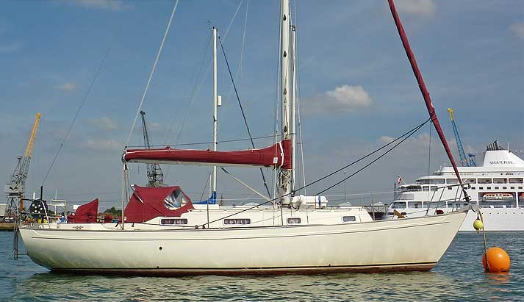
Handicap of 0.957
Victoria 34
(1 hour 2 min 18 secs)

Slide 25
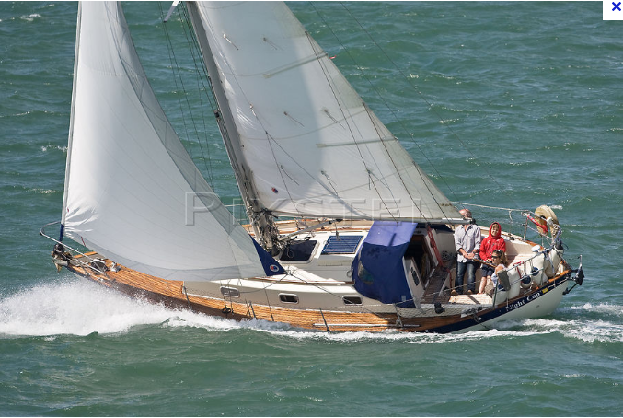
Handicap of 0.888
Victoria 30 (1 hour 6 min 32 secs)

Slide 26
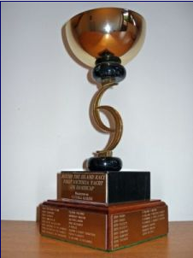
The Victoria Cup

Slide 27


Finish
time
Elapsed
time
Corrected
time
Sail No
Name
TCC
Class
Victoria 30
Victoria 34

Slide 28
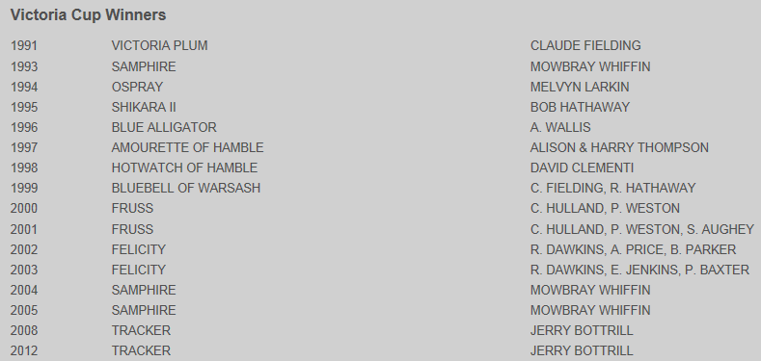

Slide 29
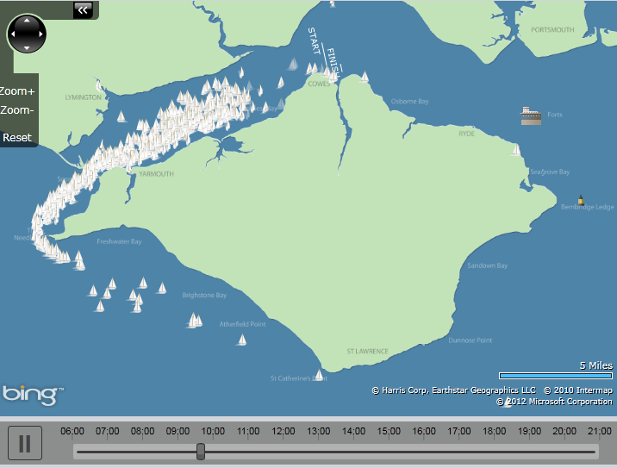
09.40

Slide 30
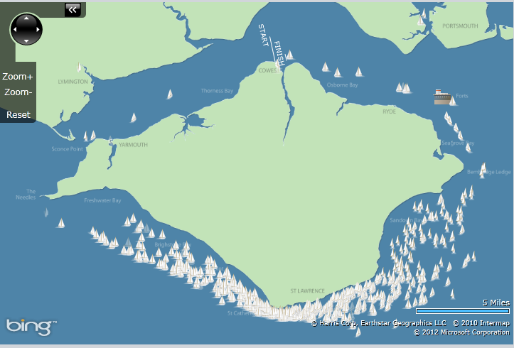
13.00

Slide 31
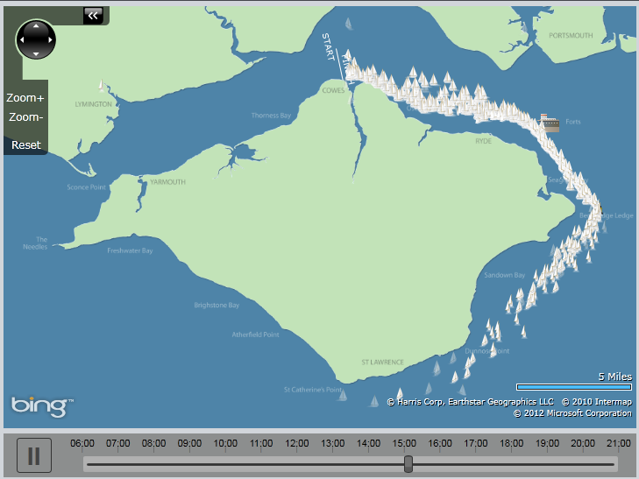
15.00

Slide 32
Preparation
Growing concern as to the number of boats skippered by people who don’t know the rules !
Sail number and also on the hull
Display coloured fleet flag (provided by ISC)
Anchors not over the bow
£2m third party insurance

Slide 33




Slide 34
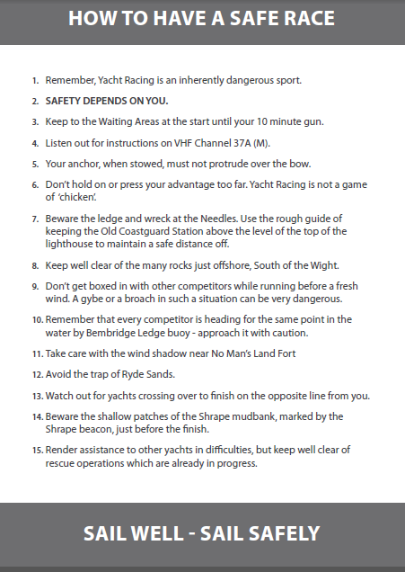

Slide 35
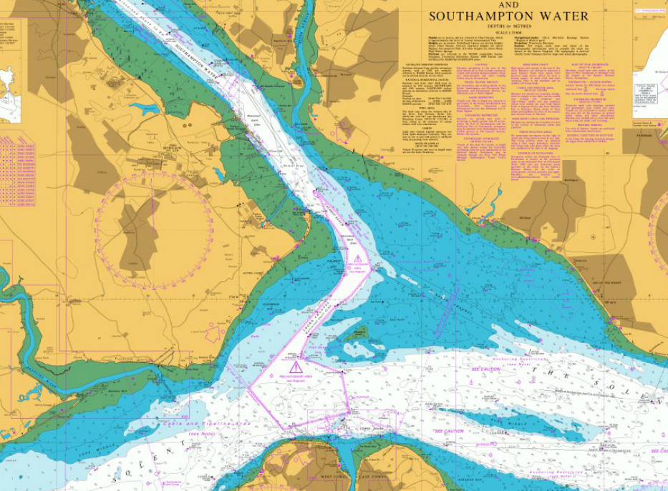
Hamble Point Marina (MDL)

Slide 36


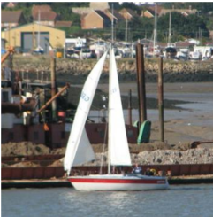
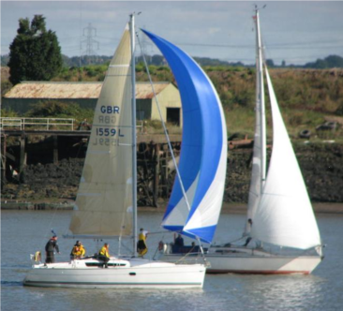
Race Training

Slide 37
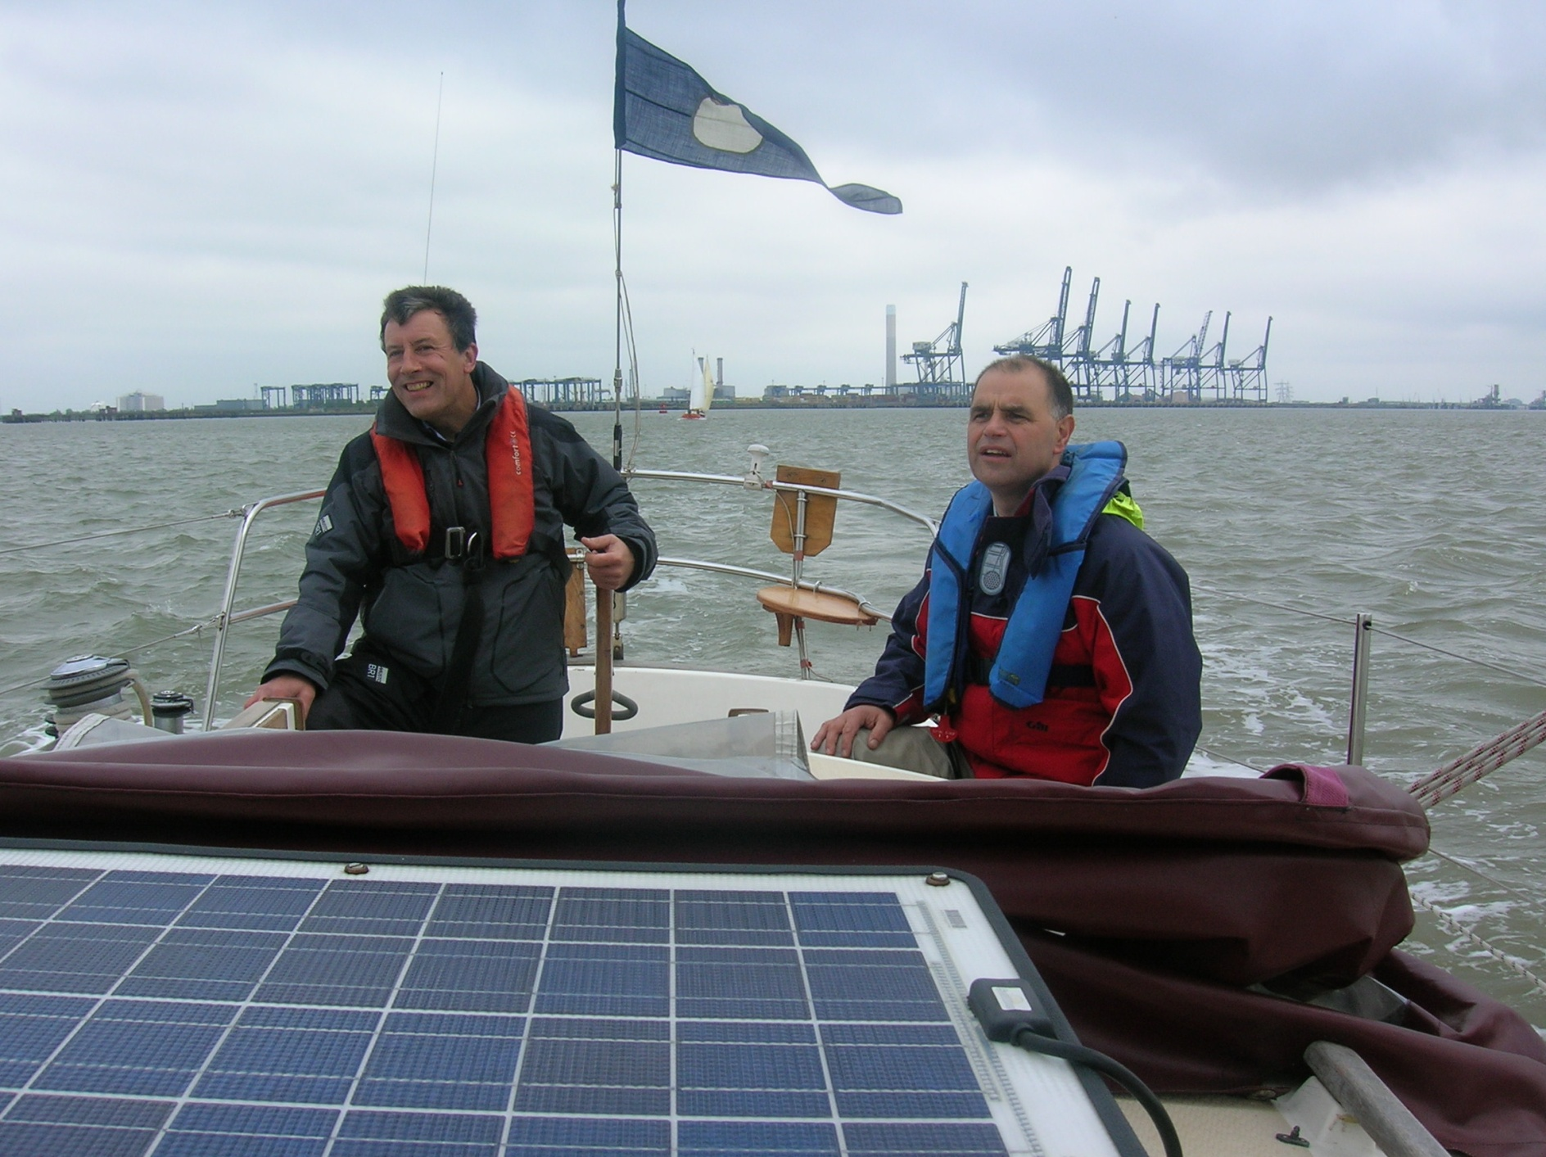

Slide 38

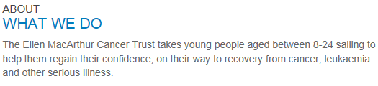
Sponsorship
£1,000 raised by Santy

Slide 39
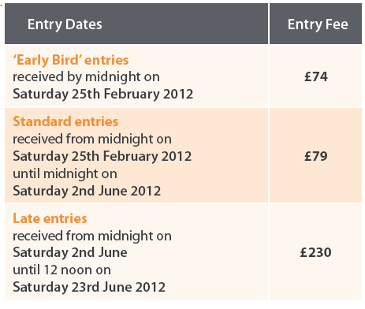
Next year !

Slide 40
Saturday 1 June 2013

